Slide 1
Pointers

Slide 2
Introduction
Pointer is a variable that stores/points to the address of another variable.
It is a derived data type in C.
It is a built from the fundamental data types.
A variable name directly references a value.
A pointer variable must be declared before it can be used.
Each memory cell in the computer has an address that can be used to access that location so a pointer variable points to a memory location we can access and change the contents of this memory location via the pointer.

Slide 3
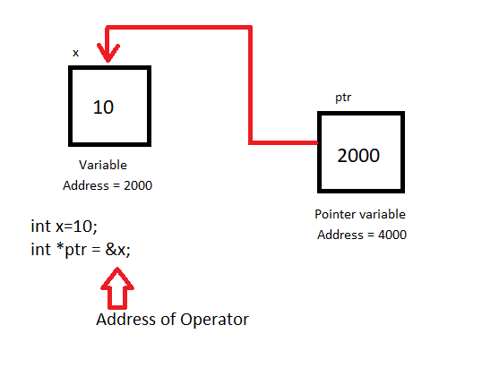
Contd….

Slide 4
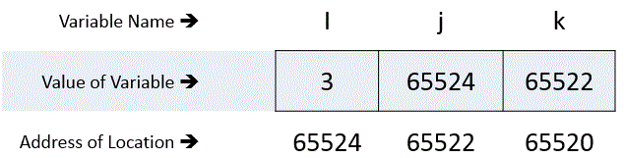
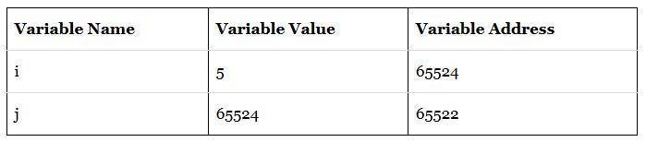
Introduction
Pointer is a variable that stores/points to the address of another variable.
C pointer is used to allocate memory dynamically i.e. at runtime.
i is the name given for particular memory location of ordinary variable.
Let us consider, its corresponding address be 65524 and the value stored in variable ‘i’ is 3.
The address of the variable ‘i’ is stored in another integer variable whose name is ‘j’ and which is having corresponding address 65522.
Reference pointer (&) : If var is a variable then, &var is the address in memory.
j = &i i.e. j = Address of i

Slide 5
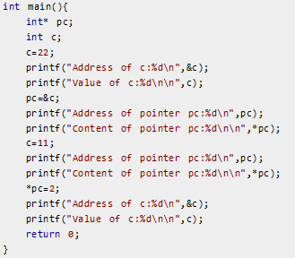
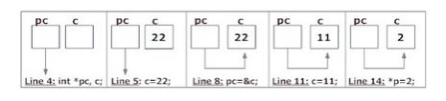
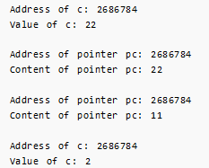
Introduction
Declaration of pointer
Dereference pointer(*) are used for defining pointer variable.
data_type* pointer_variable_name;
int* p; → p as pointer variable of type int.
& symbol is used to get the address of the variable.
* symbol is used to get the value of the variable that the pointer is pointing to. This is known as indirection operator or dereferencing operator. It is a unary operator.

Slide 6
Computer Memory Revisited
Computers store data in memory slots
Each slot has an unique address
Variables store their values like this:
Addr | Content | Addr | Content | Addr | Content | Addr | Content
1000 | i: 37 | 1001 | j: 46 | 1002 | k: 58 | 1003 | m: 74
1004 | a[0]: ‘a’ | 1005 | a[1]: ‘b’ | 1006 | a[2]: ‘c’ | 1007 | a[3]: ‘\0’
1008 | ptr: 1001 | 1009 | … | 1010 |  | 1011

Slide 7
Computer Memory Revisited
Altering the value of a variable is indeed changing the content of the memory
e.g. i = 40; a[2] = ‘z’;
Addr | Content | Addr | Content | Addr | Content | Addr | Content
1000 | i: 40 | 1001 | j: 46 | 1002 | k: 58 | 1003 | m: 74
1004 | a[0]: ‘a’ | 1005 | a[1]: ‘b’ | 1006 | a[2]: ‘z’ | 1007 | a[3]: ‘\0’
1008 | ptr: 1001 | 1009 | … | 1010 |  | 1011
Notes:
Is there any questions so far?

Slide 8
Addressing Concept
Pointer stores the address of another entity
It refers to a memory location
int i = 5;
int *ptr; /* declare a pointer variable */
ptr = &i; /* store address-of i to ptr */
printf(“*ptr = %d\n”, *ptr); /* refer to referee of ptr */
Notes:
As its name suggests, … Syntactically, a pointer variable is declared as a type identifier followed by an asterisk “*”.

Slide 9
What actually ptr is?
ptr is a variable storing an address
ptr is NOT storing the actual value of i
ptr
address of i
int i = 5;
int *ptr;
ptr = &i;
printf(“i = %d\n”, i);
printf(“*ptr = %d\n”, *ptr);
printf(“ptr = %p\n”, ptr);
i
5
Output:
i = 5
*ptr = 5
ptr = effff5e0
value of ptr = address of i
in memory
Notes:
This code segment appeared in the appetizer.

Slide 10
Twin Operators
&: Address-of operator
Get the address of an entity
e.g. ptr = &j;
Addr | Content | Addr | Content | Addr | Content | Addr | Content
1000 | i: 40 | 1001 | j: 33 | 1002 | k: 58 | 1003 | m: 74
1004 | ptr: 1001 | 1005 |  | 1006 |  | 1007

Slide 11
Twin Operators
*: De-reference operator
Refer to the content of the referee
e.g. *ptr = 99;
Addr | Content | Addr | Content | Addr | Content | Addr | Content
1000 | i: 40 | 1001 | j: 99 | 1002 | k: 58 | 1003 | m: 74
1004 | ptr: 1001 | 1005 |  | 1006 |  | 1007

Slide 12
Example: Pass by Reference
Modify behaviour in argument passing
void f(int j)
{
j = 5;
}
void g()
{
int i = 3;
f(i);
}
void f(int *ptr)
{
*ptr = 5;
}
void g()
{
int i = 3;
f(&i);
}
i = ?
i = 3
i = ?
i = 5
Notes:
The program segment on the left is demonstrating “pass by value”, i.e. the value, actually a copy, of the variable i is passed as argument to function f(). The other program shows you “pass by reference”. The address of the variable i is passed to f() instead, thus allowing us to modify the content stored in the variable.

Slide 13
An Illustration
int i = 5, j = 10;
int *ptr;
ptr = &i;
*ptr = 3;
ptr = &j;
*ptr = -2;
Data Table
Name | Type | Description | Value
i | int | integer variable | 5
j | int | integer variable | 10

Slide 14
An Illustration
int i = 5, j = 10;
int *ptr; /* declare a pointer-to-integer variable */
ptr = &i;
*ptr = 3;
ptr = &j;
*ptr = -2;
Data Table
Name | Type | Description | Value
i | int | integer variable | 5
j | int | integer variable | 10
ptr | int * | integer pointer variable

Slide 15
An Illustration
int i = 5, j = 10;
int *ptr;
ptr = &i; /* store address-of i to ptr */
*ptr = 3;
ptr = &j;
*ptr = -2;
Data Table
Name | Type | Description | Value
i | int | integer variable | 5
j | int | integer variable | 10
ptr | int * | integer pointer variable | address of i
*ptr | int | de-reference of ptr | 5

Slide 16
An Illustration
int i = 5, j = 10;
int *ptr;
ptr = &i;
*ptr = 3;
ptr = &j;
*ptr = -2;
Data Table
Name | Type | Description | Value
i | int | integer variable | 3
j | int | integer variable | 10
ptr | int * | integer pointer variable | address of i
*ptr | int | de-reference of ptr | 3

Slide 17
An Illustration
int i = 5, j = 10;
int *ptr;
ptr = &i;
*ptr = 3;
ptr = &j;
*ptr = -2;
Data Table
Name | Type | Description | Value
i | int | integer variable | 7
j | int | integer variable | 10
ptr | int * | integer pointer variable | address of j
*ptr | int | de-reference of ptr | 10

Slide 18
An Illustration
int i = 5, j = 10;
int *ptr;
ptr = &i;
*ptr = 3;
ptr = &j;
*ptr = -2;
Data Table
Name | Type | Description | Value
i | int | integer variable | -2
j | int | integer variable | 9
ptr | int * | integer pointer variable | address of i
*ptr | int | de-reference of ptr | -2

Slide 19
Pointer Declaration
Pointer Declaration Style:
int* p; /*Style 1*/
int *p; /*Style 2*/
int * p; /*Style 3*/
Style 2 is popular because, convenient to have multiple declaration in the same statement. Like,
int *p, x, *q;
This style matches with the format used for accessing the target values.
For example,
int x, *p, y;
x=10;
p = &x;
y= *p;
*p= 20;

Slide 20
Initialization of pointer variables
The Process of assigning the address of a variable to a pointer variable is known as initialization.
Way1: int quantity;
int *p;
p=&quantity;
Way 2: int quantity;
int *p=&quantity;
Way 3: int x, *p=&x; (valid)
int *p=&x, x; (invalid)
Way 4: int *p = NULL;

Slide 21
Initialization of pointer variables
Pointer flexibility:
We can make the same pointer to point to different data variables in different statements.
For example,
int x, y, z, *p;
………….
p=&x;
………….
p=&y;
………….
p=&z;
………….

Slide 22
Initialization of pointer variables
Pointer flexibility:
We can also use different pointers to point to same data variable.
For example,
int x;
int *p1 = &x;
int *p2 = &x;
int *p3 = &x;
The two statements,
p=&q;
n=*p;
are equivalent to
n=*&q;
which in turn is equivalent to
n=q;

Slide 23
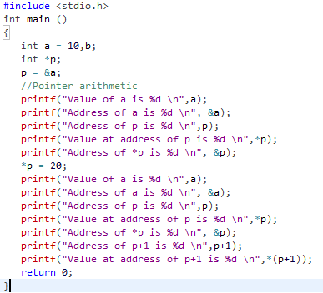
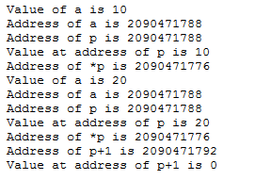
Pointer Arithmetic

Slide 24
Pointer Arithmetic
What’s ptr + 1?
The next memory location!
What’s ptr - 1?
The previous memory location!
What’s ptr * 2 and ptr / 2?
Invalid operations!!!

Slide 25
Pointer Arithmetic and Array
float a[4];
float *ptr;
ptr = &(a[2]);
*ptr = 3.14;
ptr++;
*ptr = 9.0;
ptr = ptr - 3;
*ptr = 6.0;
ptr += 2;
*ptr = 7.0;
Data Table
Name | Type | Description | Value
a[0] | float | float array element (variable) | ?
a[1] | float | float array element (variable) | ?
a[2] | float | float array element (variable) | ?
a[3] | float | float array element (variable) | ?
ptr | float * | float pointer variable
*ptr | float | de-reference of float pointer variable | ?

Slide 26
Pointer Arithmetic and Array
float a[4];
float *ptr;
ptr = &(a[2]);
*ptr = 3.14;
ptr++;
*ptr = 9.0;
ptr = ptr - 3;
*ptr = 6.0;
ptr += 2;
*ptr = 7.0;
Data Table
Name | Type | Description | Value
a[0] | float | float array element (variable) | ?
a[1] | float | float array element (variable) | ?
a[2] | float | float array element (variable) | ?
a[3] | float | float array element (variable) | ?
ptr | float * | float pointer variable | address of a[2]
*ptr | float | de-reference of float pointer variable | ?

Slide 27
Pointer Arithmetic and Array
float a[4];
float *ptr;
ptr = &(a[2]);
*ptr = 3.14;
ptr++;
*ptr = 9.0;
ptr = ptr - 3;
*ptr = 6.0;
ptr += 2;
*ptr = 7.0;
Data Table
Name | Type | Description | Value
a[0] | float | float array element (variable) | ?
a[1] | float | float array element (variable) | ?
a[2] | float | float array element (variable) | 3.14
a[3] | float | float array element (variable) | ?
ptr | float * | float pointer variable | address of a[2]
*ptr | float | de-reference of float pointer variable | 3.14

Slide 28
Pointer Arithmetic and Array
float a[4];
float *ptr;
ptr = &(a[2]);
*ptr = 3.14;
ptr++;
*ptr = 9.0;
ptr = ptr - 3;
*ptr = 6.0;
ptr += 2;
*ptr = 7.0;
Data Table
Name | Type | Description | Value
a[0] | float | float array element (variable) | ?
a[1] | float | float array element (variable) | ?
a[2] | float | float array element (variable) | 3.14
a[3] | float | float array element (variable) | ?
ptr | float * | float pointer variable | address of a[3]
*ptr | float | de-reference of float pointer variable | ?

Slide 29
Pointer Arithmetic and Array
float a[4];
float *ptr;
ptr = &(a[2]);
*ptr = 3.14;
ptr++;
*ptr = 9.0;
ptr = ptr - 3;
*ptr = 6.0;
ptr += 2;
*ptr = 7.0;
Data Table
Name | Type | Description | Value
a[0] | float | float array element (variable) | ?
a[1] | float | float array element (variable) | ?
a[2] | float | float array element (variable) | 3.14
a[3] | float | float array element (variable) | 9.0
ptr | float * | float pointer variable | address of a[3]
*ptr | float | de-reference of float pointer variable | 9.0

Slide 30
Pointer Arithmetic and Array
float a[4];
float *ptr;
ptr = &(a[2]);
*ptr = 3.14;
ptr++;
*ptr = 9.0;
ptr = ptr - 3;
*ptr = 6.0;
ptr += 2;
*ptr = 7.0;
Data Table
Name | Type | Description | Value
a[0] | float | float array element (variable) | ?
a[1] | float | float array element (variable) | ?
a[2] | float | float array element (variable) | 3.14
a[3] | float | float array element (variable) | 9.0
ptr | float * | float pointer variable | address of a[0]
*ptr | float | de-reference of float pointer variable | ?

Slide 31
Pointer Arithmetic and Array
float a[4];
float *ptr;
ptr = &(a[2]);
*ptr = 3.14;
ptr++;
*ptr = 9.0;
ptr = ptr - 3;
*ptr = 6.0;
ptr += 2;
*ptr = 7.0;
Data Table
Name | Type | Description | Value
a[0] | float | float array element (variable) | 6.0
a[1] | float | float array element (variable) | ?
a[2] | float | float array element (variable) | 3.14
a[3] | float | float array element (variable) | 9.0
ptr | float * | float pointer variable | address of a[0]
*ptr | float | de-reference of float pointer variable | 6.0

Slide 32
Pointer Arithmetic and Array
float a[4];
float *ptr;
ptr = &(a[2]);
*ptr = 3.14;
ptr++;
*ptr = 9.0;
ptr = ptr - 3;
*ptr = 6.0;
ptr += 2;
*ptr = 7.0;
Data Table
Name | Type | Description | Value
a[0] | float | float array element (variable) | 6.0
a[1] | float | float array element (variable) | ?
a[2] | float | float array element (variable) | 3.14
a[3] | float | float array element (variable) | 9.0
ptr | float * | float pointer variable | address of a[2]
*ptr | float | de-reference of float pointer variable | 3.14

Slide 33
Pointer Arithmetic and Array
float a[4];
float *ptr;
ptr = &(a[2]);
*ptr = 3.14;
ptr++;
*ptr = 9.0;
ptr = ptr - 3;
*ptr = 6.0;
ptr += 2;
*ptr = 7.0;
Data Table
Name | Type | Description | Value
a[0] | float | float array element (variable) | 6.0
a[1] | float | float array element (variable) | ?
a[2] | float | float array element (variable) | 7.0
a[3] | float | float array element (variable) | 9.0
ptr | float * | float pointer variable | address of a[2]
*ptr | float | de-reference of float pointer variable | 7.0

Slide 34
Pointer Arithmetic and Array
float a[4];
float *ptr;
ptr = &(a[2]);
*ptr = 3.14;
ptr++;
*ptr = 9.0;
ptr = ptr - 3;
*ptr = 6.0;
ptr += 2;
*ptr = 7.0;
Type of a is float *
a[2] ⬅➔ *(a + 2)
ptr = &(a[2])
ptr = &(*(a + 2))
ptr = a + 2
a is a memory address constant
ptr is a pointer variable

Slide 35
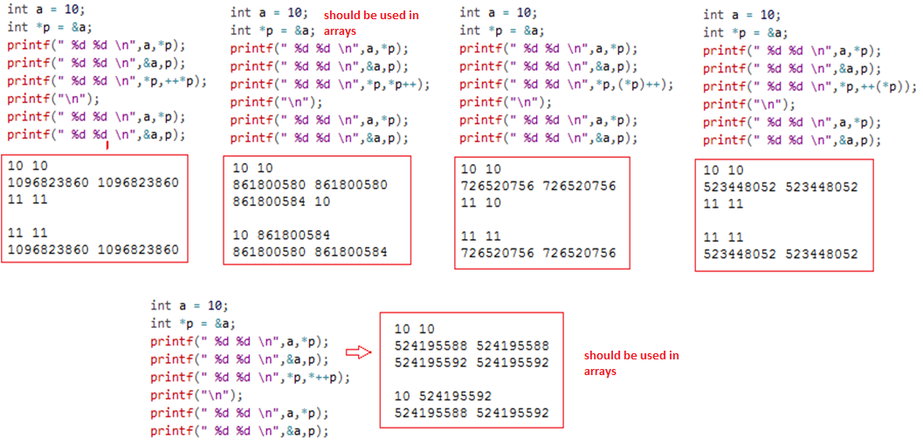
Pointer Increment

Slide 36
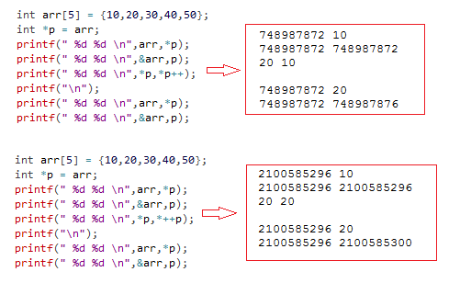
Pointer Increment

Slide 37
void pointer
Suppose we have to declare integer pointer, character pointer and float pointer, then we need to declare 3 pointer variables.
Instead of declaring different types of pointer variable it is feasible to declare single pointer variable which can act as integer pointer, character pointer.
In C, General Purpose Pointer is called as void Pointer.
It does not have any data type associated with it.
It can store address of any type of variable.
A void pointer is a C convention for a raw address.
The compiler has no idea what type of object a void Pointer really points to?
Declaration of void pointer : void *pointer_name;
Why use void pointer ? → Reusability of pointers

Slide 38
void pointer
void *ptr; // ptr is declared as Void pointer
char cnum;
int inum;
float fnum;
ptr = &cnum; // ptr has address of character data
ptr = &inum; // ptr has address of integer data
ptr = &fnum; // ptr has address of float data
We have declared 3 variables of integer, character and float type.
When we assign address of integer to the void pointer, pointer will become Integer Pointer.
When we assign address of Character Data type to void pointer it will become Character Pointer.
Similarly we can assign address of any data type to the void pointer.
It is capable of storing address of any data type

Slide 39
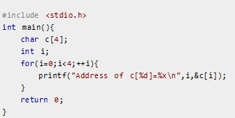


Pointers and Arrays
int arr[4];
Name of the array is actually a pointer that points to the first element of the array.
Here, address of first element of an array is &arr[0].
Also, arr represents the address of the pointer where it is pointing. Hence, &arr[0] is equivalent to arr.
Also, value inside the address &arr[0] and address arr are equal.
Value in address &arr[0] is arr[0] and value in address arr is *arr. Hence, arr[0] is equivalent to *arr.

Slide 40
Pointers and Arrays
Similarly,
&a[1] is equivalent to (a+1) AND, a[1] is equivalent to *(a+1).
&a[2] is equivalent to (a+2) AND, a[2] is equivalent to *(a+2).
&a[3] is equivalent to (a+1) AND, a[3] is equivalent to *(a+3).
…
&a[i] is equivalent to (a+i) AND, a[i] is equivalent to *(a+i).

Slide 41
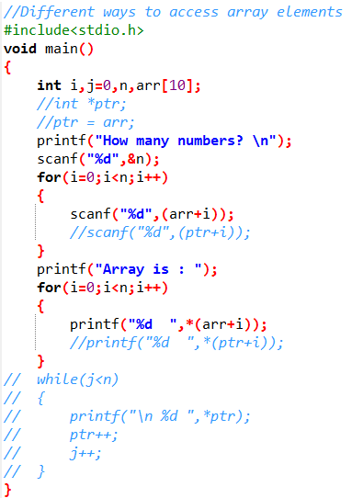
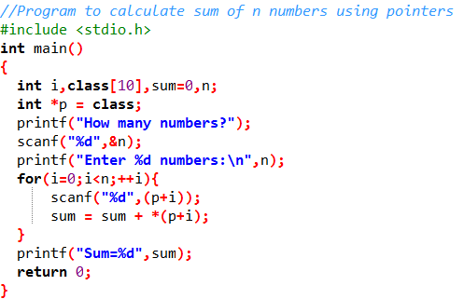
Pointers and Arrays

Slide 42
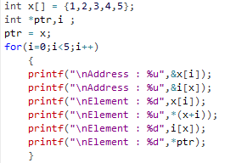
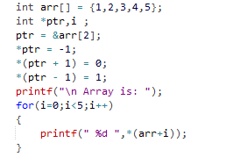
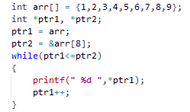
Pointers and Arrays

Slide 43
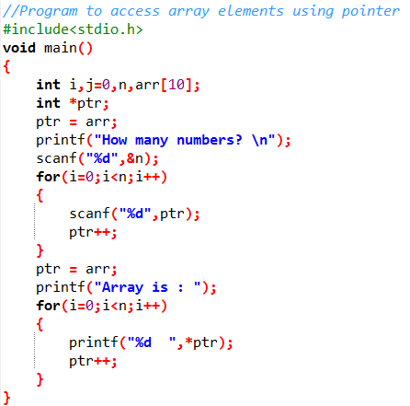
Pointers and Arrays

Slide 44
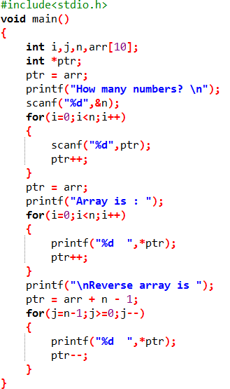
Pointers and Arrays
Program for accessing array elements and
printing array elements in reverse using
pointer.

Slide 45
Some programs on arrays using pointer
Program for accessing array elements and print array elements in reverse order using pointer.
Program for sorting n numbers in an array using pointer.
Program for finding reverse of a string using pointer.
Program to manipulate string using pointer (i.e find length, compare, concatenate and copy string)

Slide 46
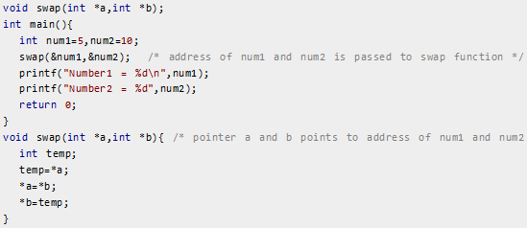
Pointers and functions – Call by reference
When, argument is passed using pointer, address of the memory location is passed instead of value.
The address of memory location num1 and num2 are passed to function and the pointers *a and *b accept those values. So, the pointer a and b points to address of num1 and num2 respectively. When, the value of pointer are changed, the value in memory location also changed correspondingly. Hence, change made to *a and *b was reflected in num1 and num2 in main function.

Slide 47
Advantages of Pointers
Pointers are more efficient in handling arrays and data tables.
Pointers reduce length and complexity of programs.
They increase the execution speed and thus reduce the program execution time.
Pointers can be used to return multiple values from a function via function arguments.
The use of pointer arrays to character strings results in saving of data storage space in memory.
Pointer permit references to functions and thereby facilitating passing of functions as arguments to other functions.
Pointers allow C to support dynamic memory management.
Pointers provide an efficient tool for manipulating dynamic structures such as structures, linked lists, stacks.

Slide 48
Disadvantages of Pointers
Uninitialized pointers might cause segmentation fault.
Dynamically allocated block needs to be freed explicitly. Otherwise, it would lead to memory leak.
Pointers are slower than normal variables.
If pointers are updated with incorrect values, it might lead to memory corruption

Slide 49
THANK YOU!!
ANY QUESTIONS??

